Slide 1

‘Please come prepared to speak for a maximum of 12 minutes on a success, a challenge and a point of learning from your project. We don’t have time for a comprehensive overview of all your activities so try to focus on shared areas of concern and what might encourage and help others at the workshop.’
Session 2: Learning from Each Other
Susan

Slide 2

Susan

Slide 3
Mitaboni Primary School
Susan

Slide 4
Thinu Primary School
Susan

Slide 5

SPAU
Susan

Slide 6
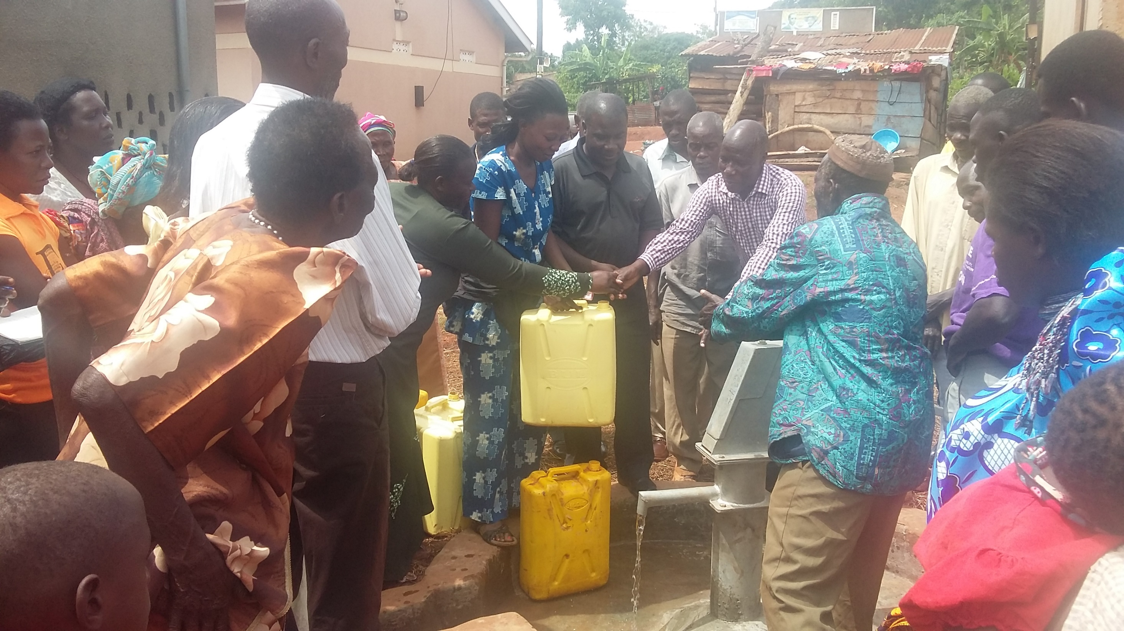

Slide 7
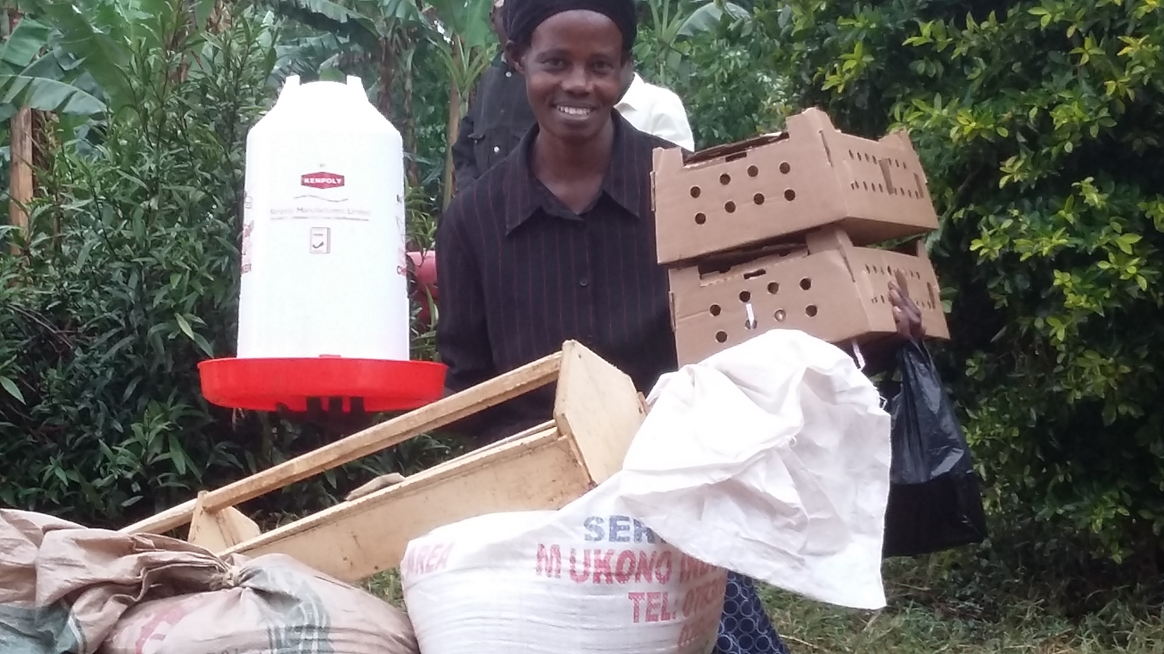

Slide 8
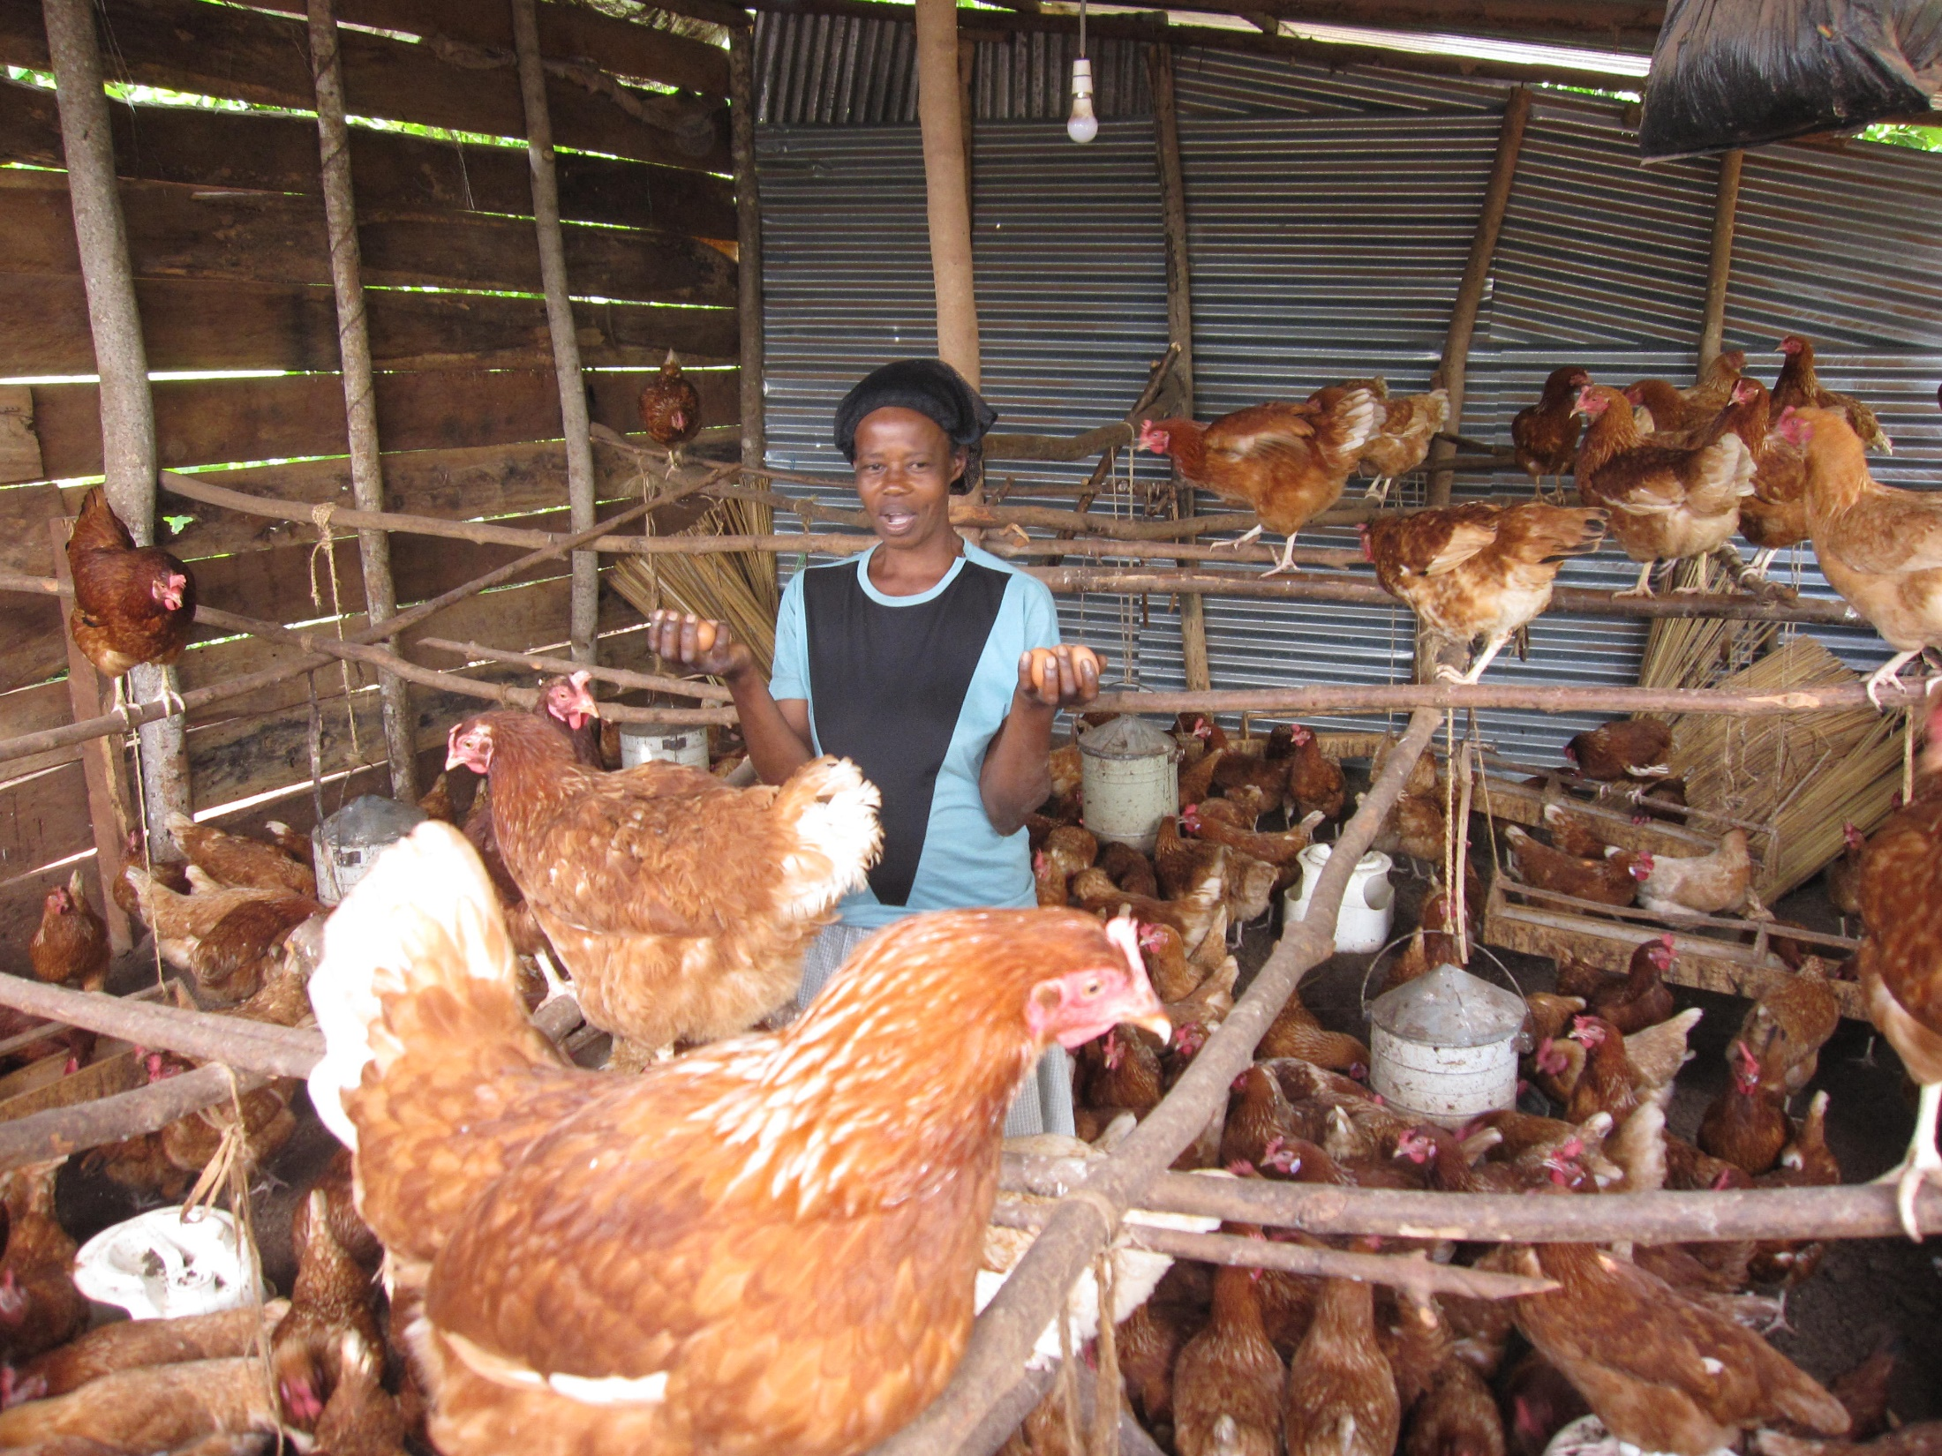

Slide 9
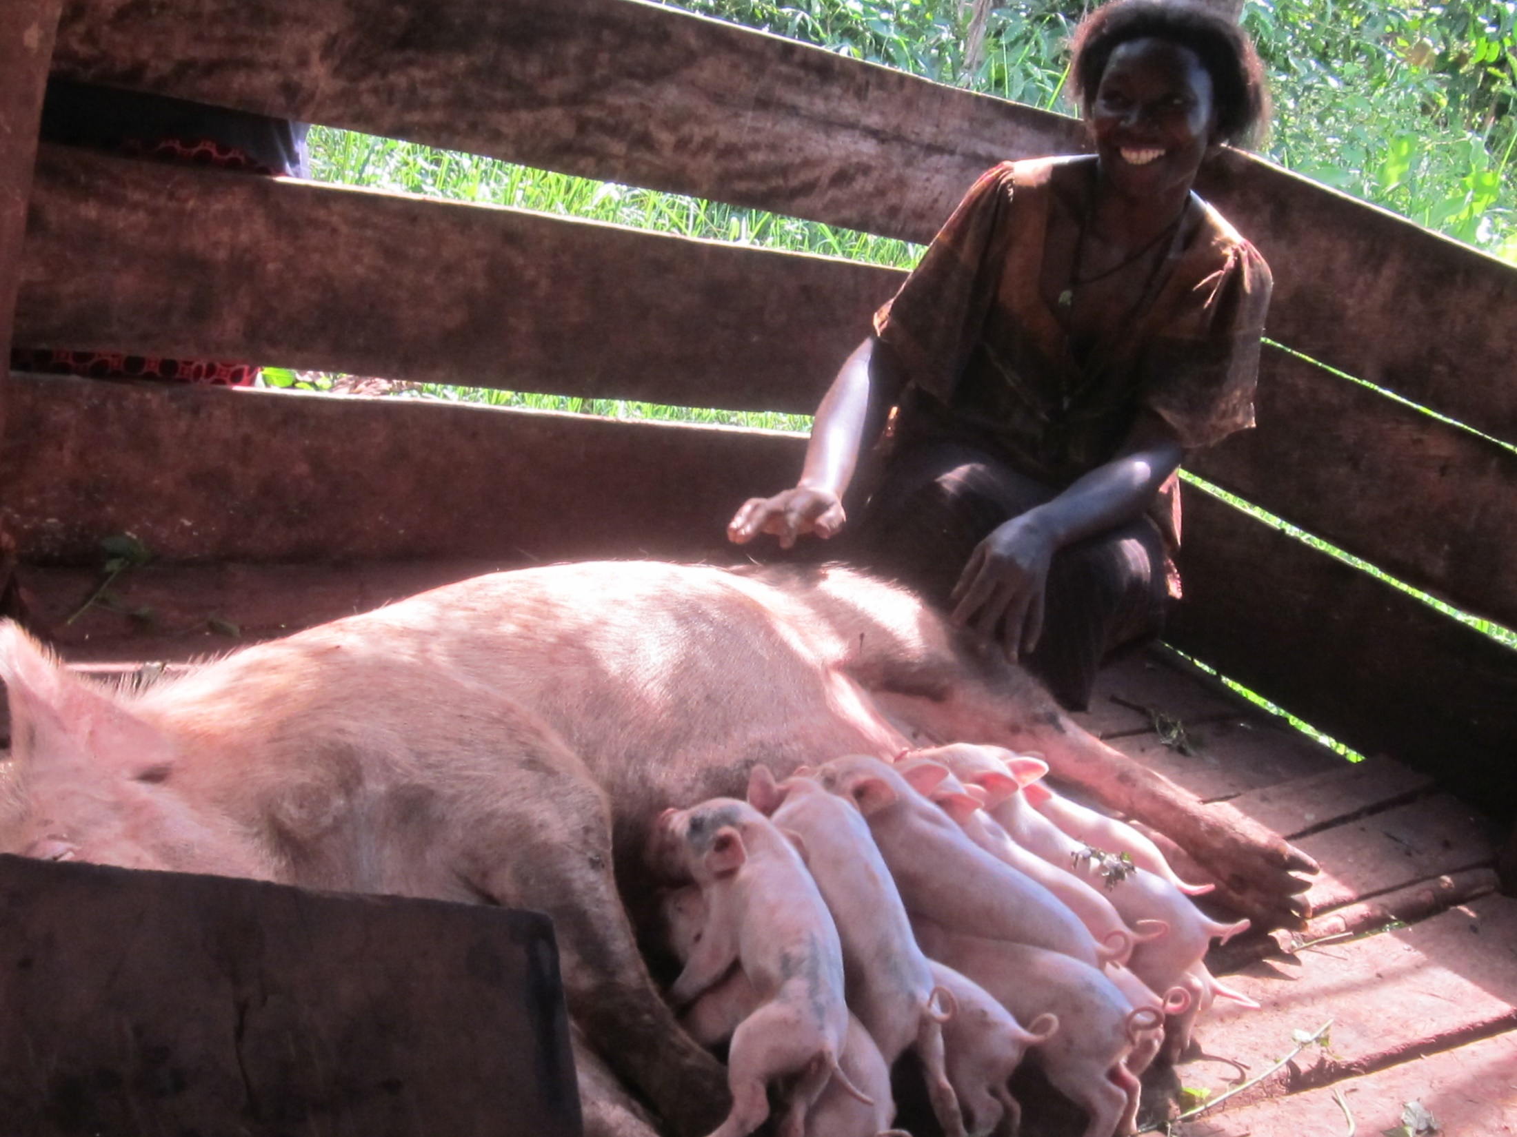

Slide 10
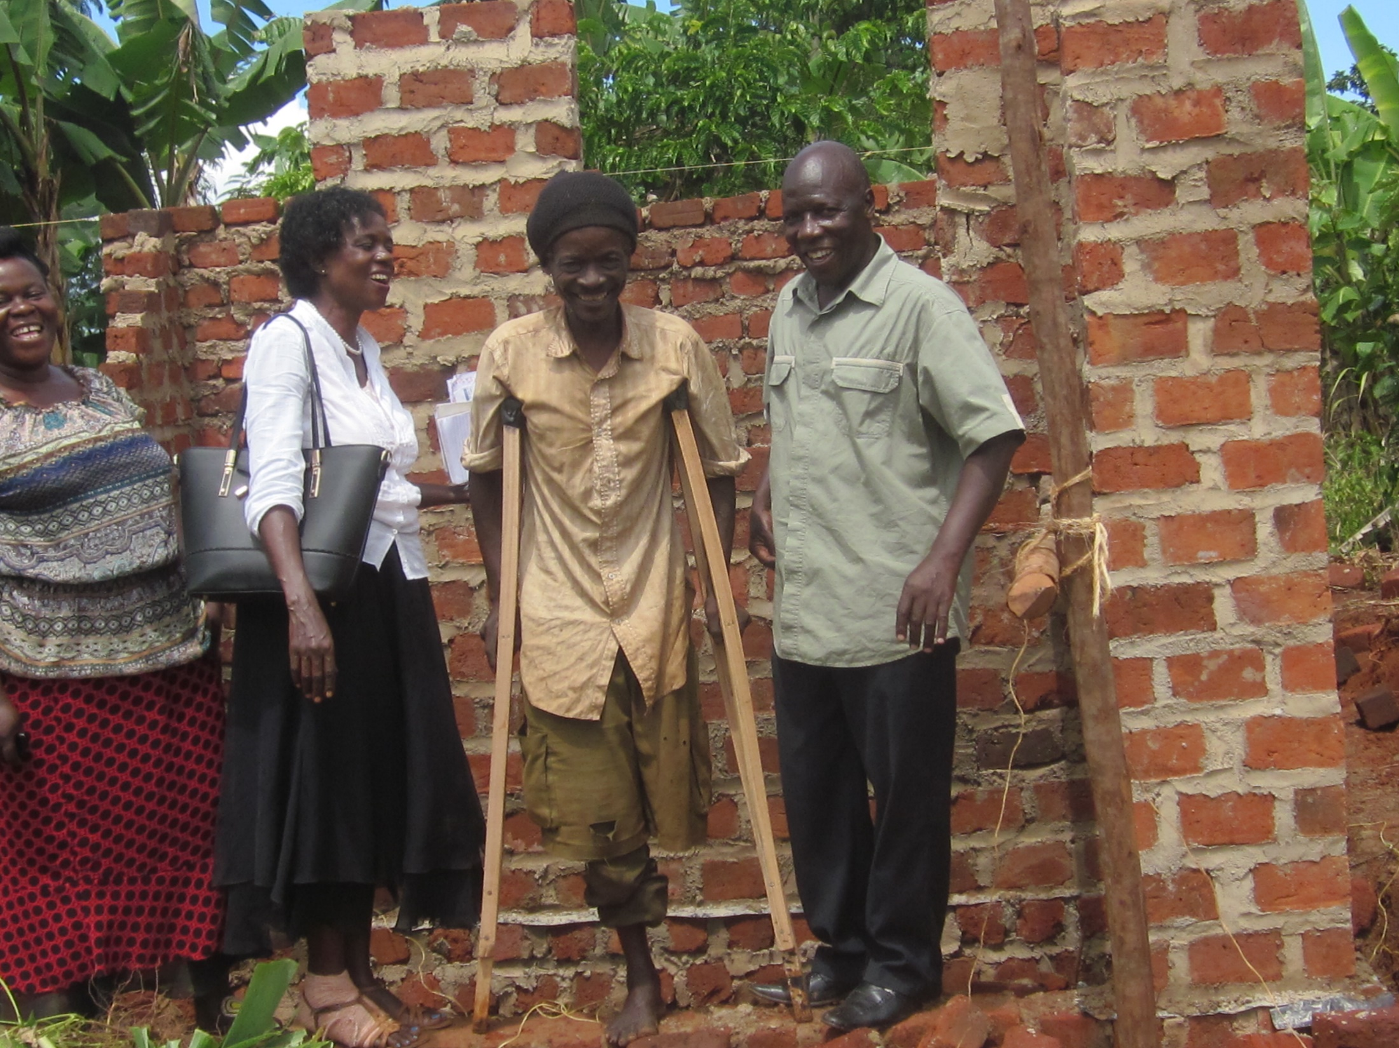

Slide 11
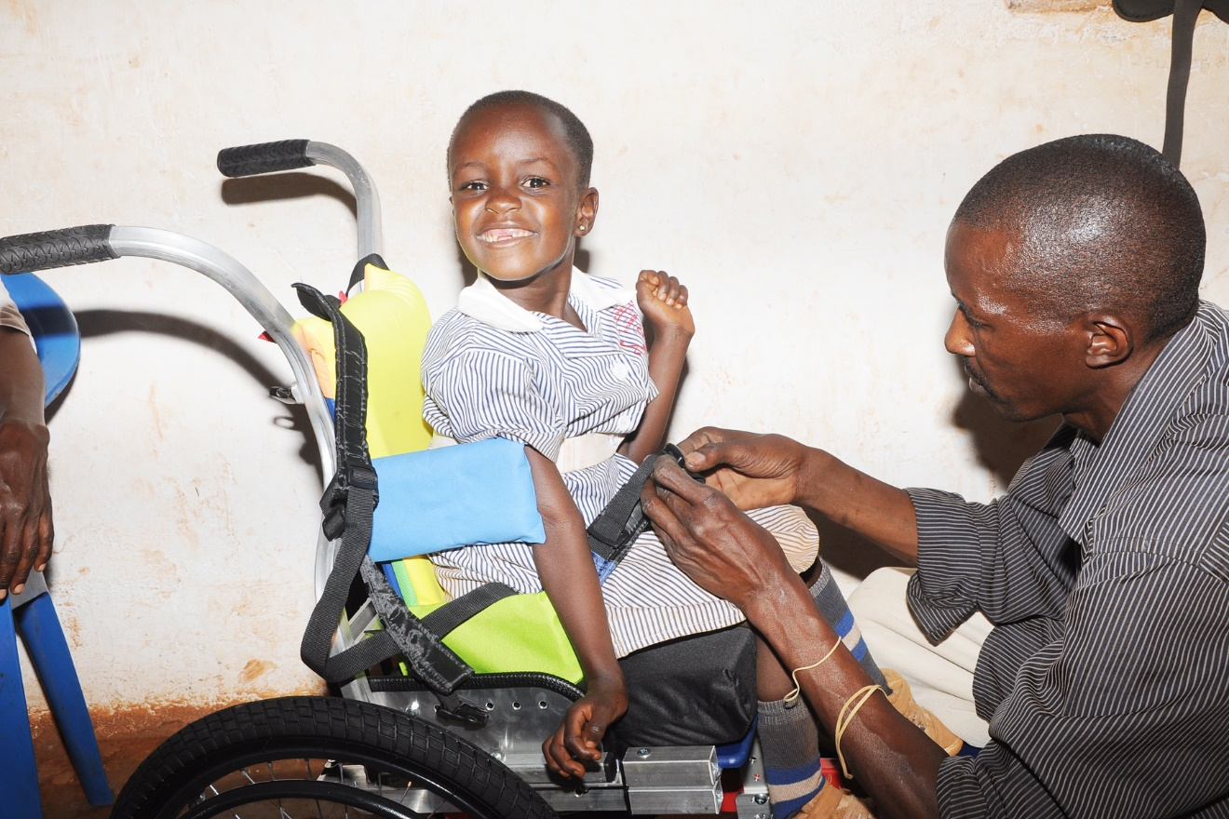

Slide 12
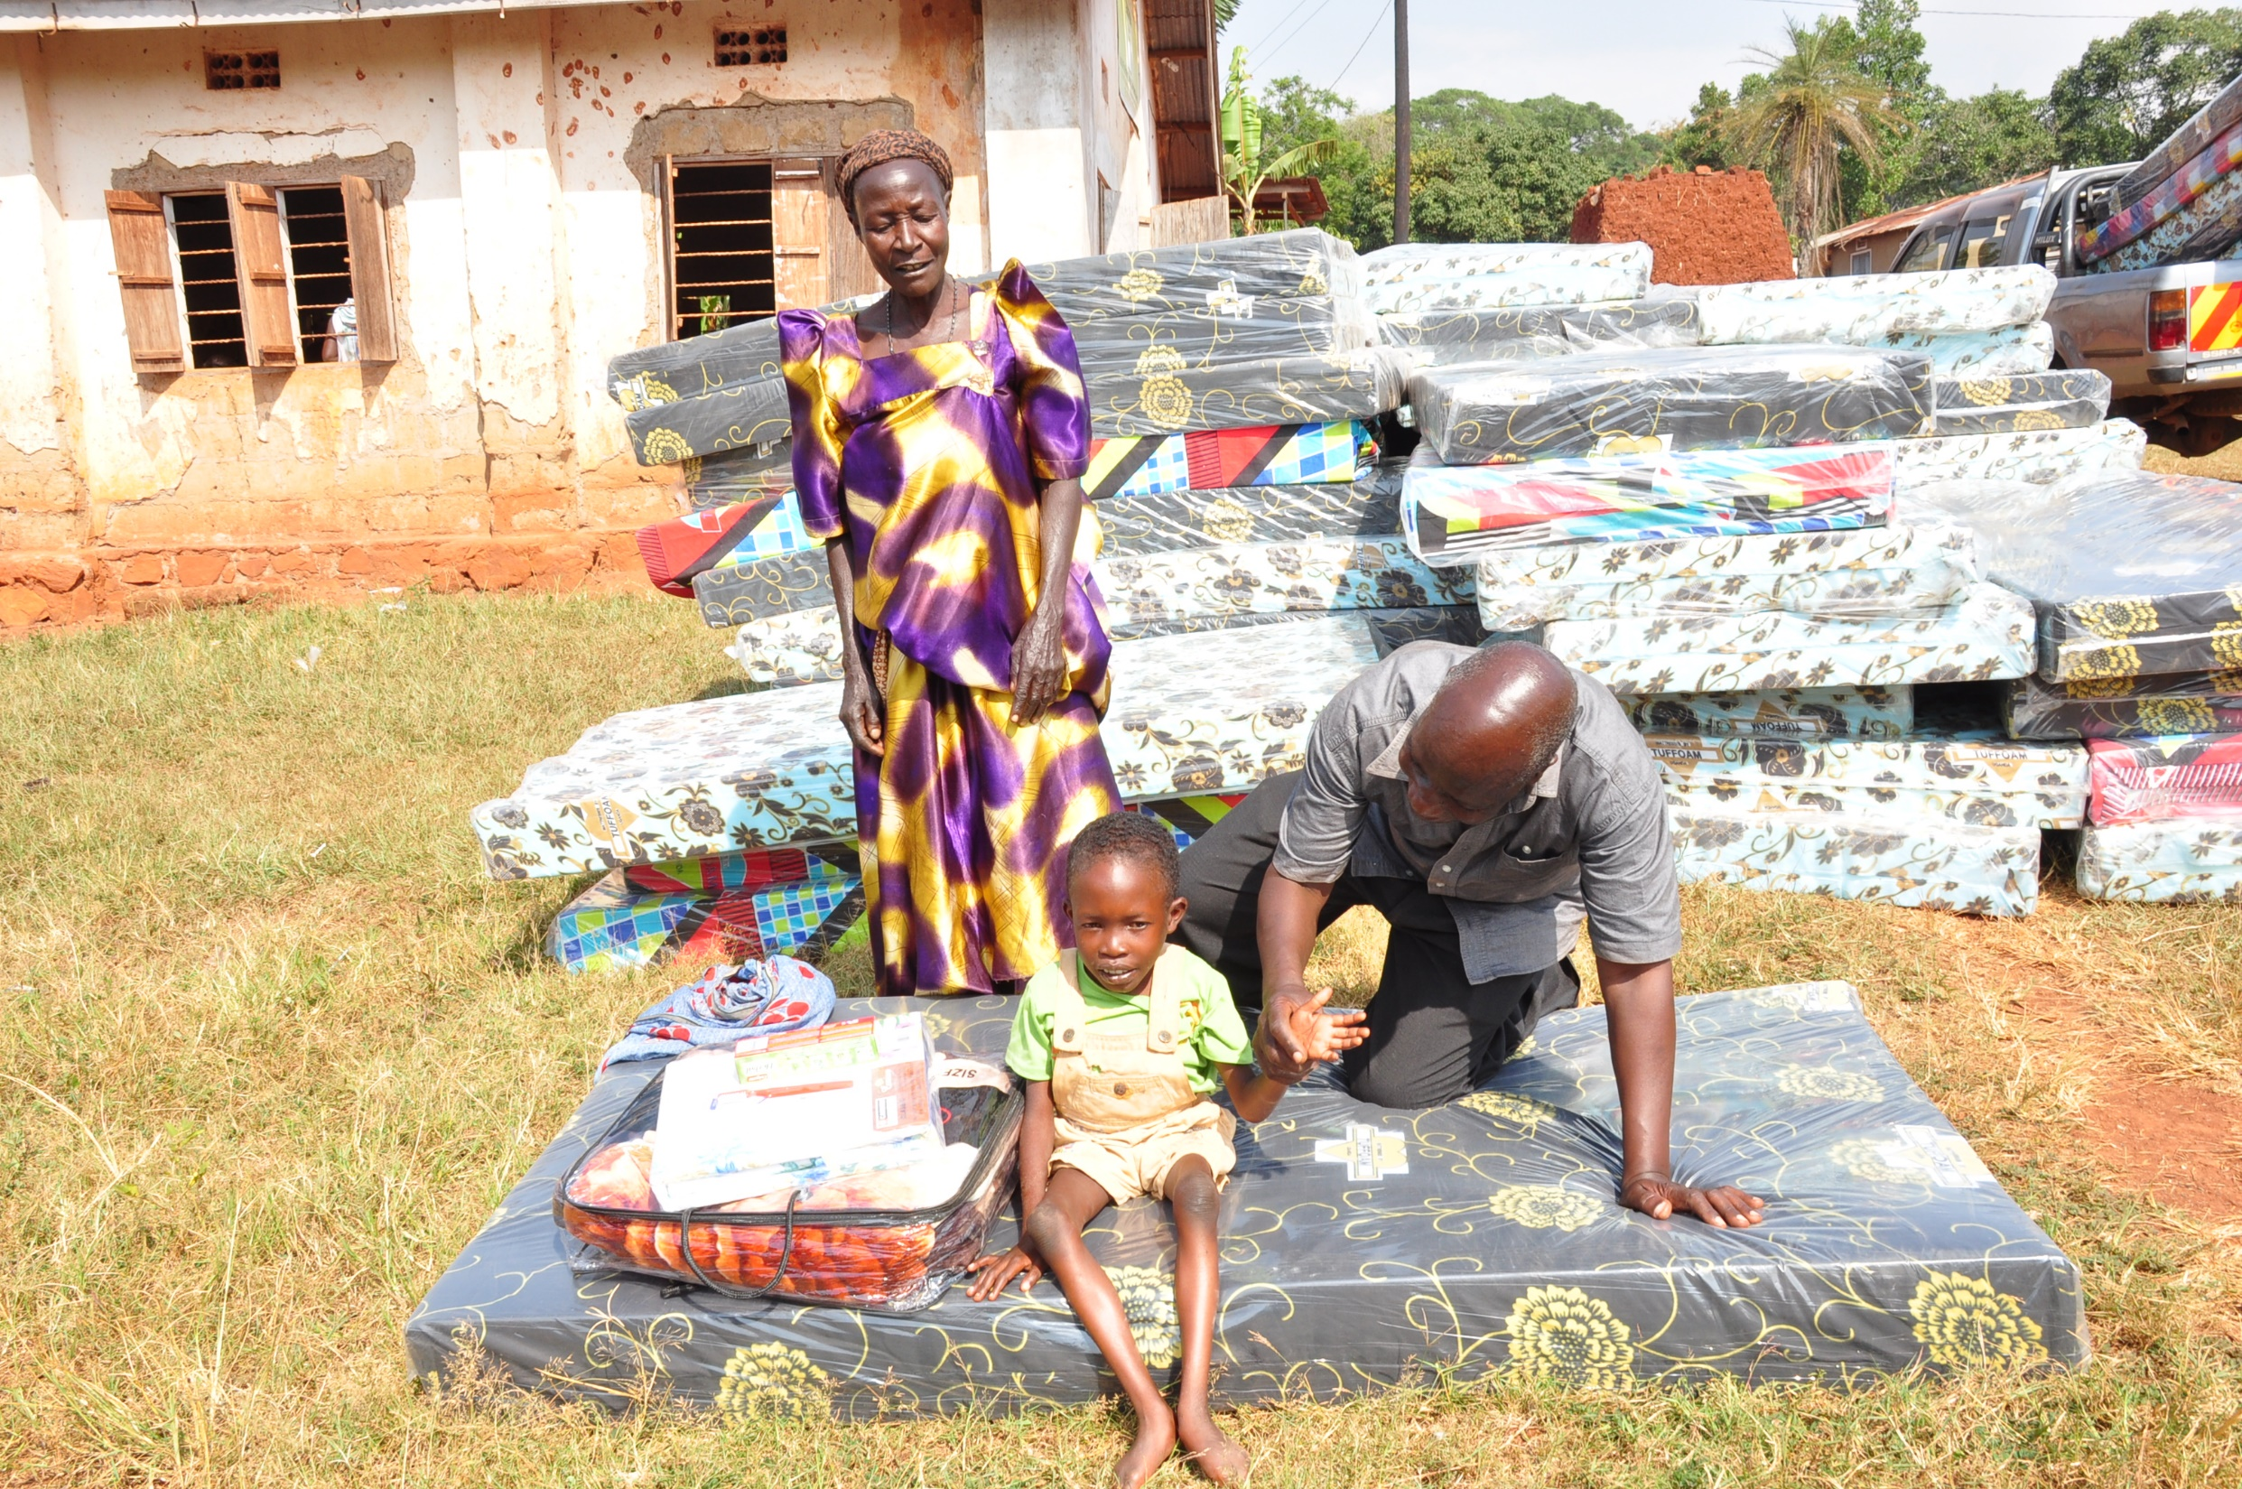

Slide 13
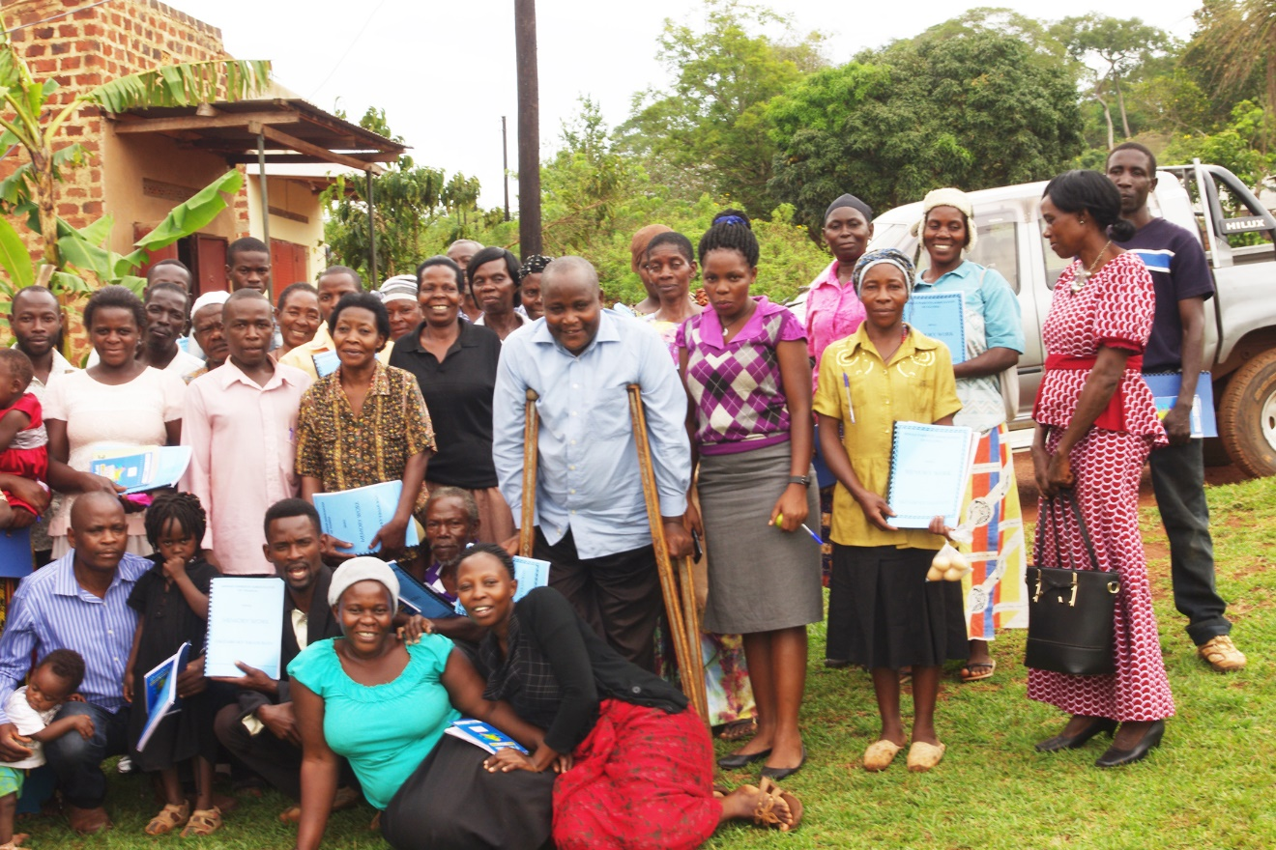

Slide 14
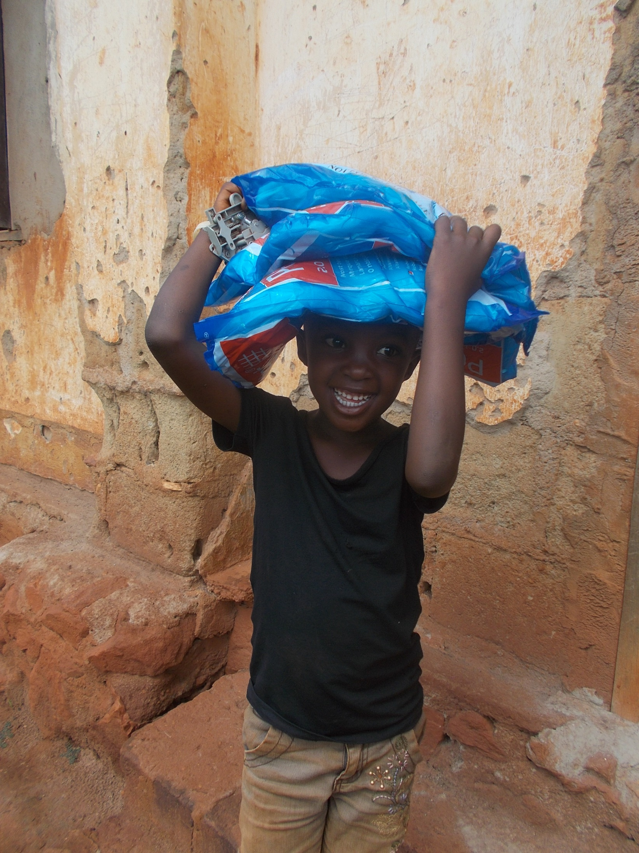

Slide 15
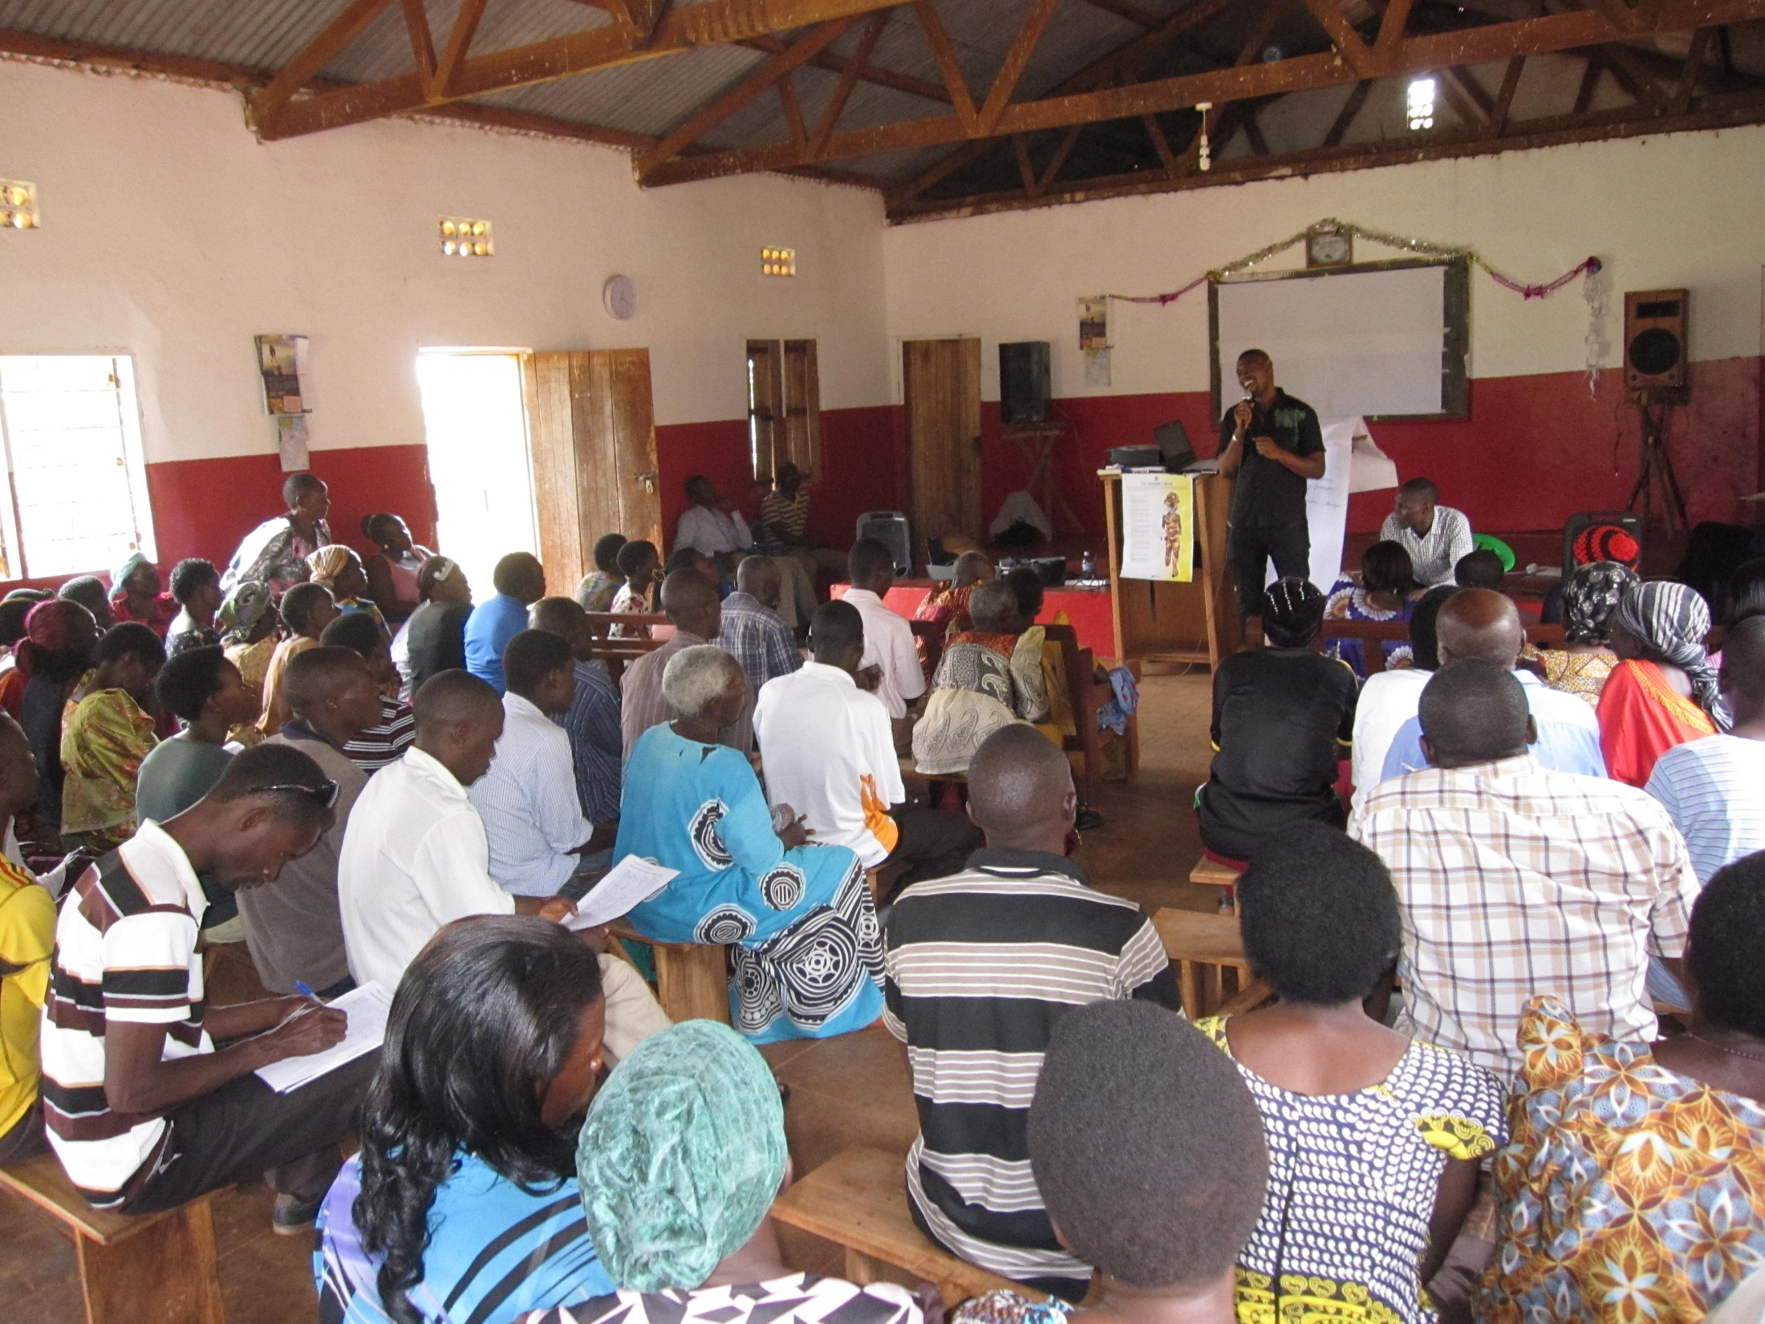

Slide 16
SNUPA
Susan

Slide 17
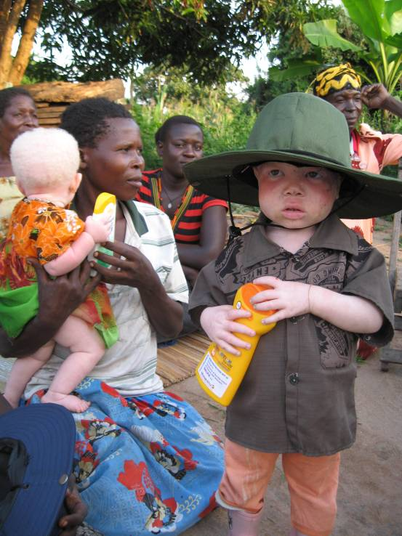
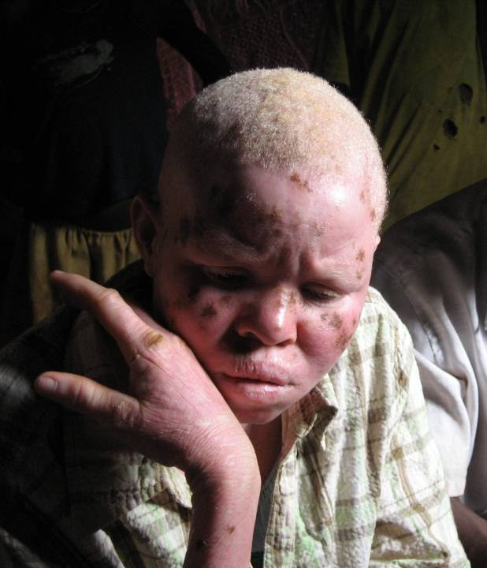
Myths (Simon)
Abuse (Lesah)

Slide 18
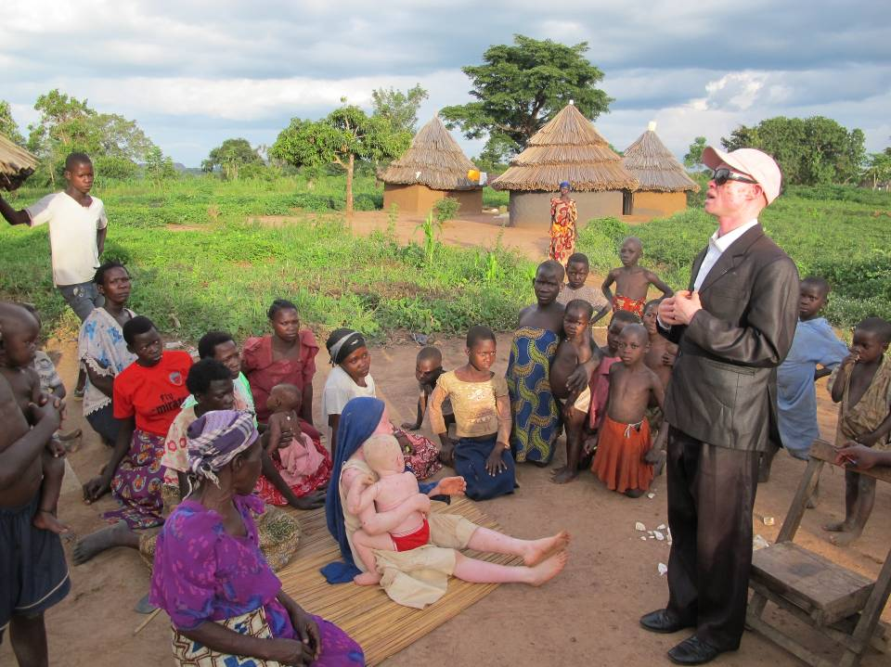
Raising Awareness

Slide 19
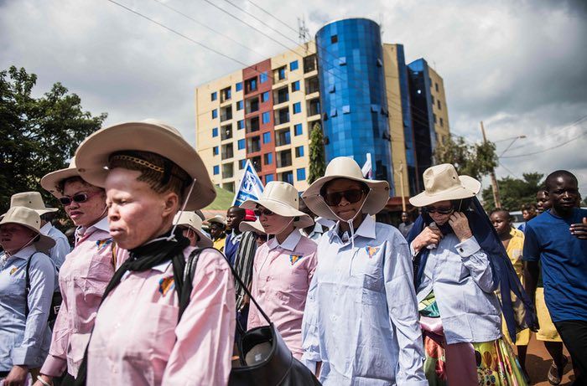

Slide 20
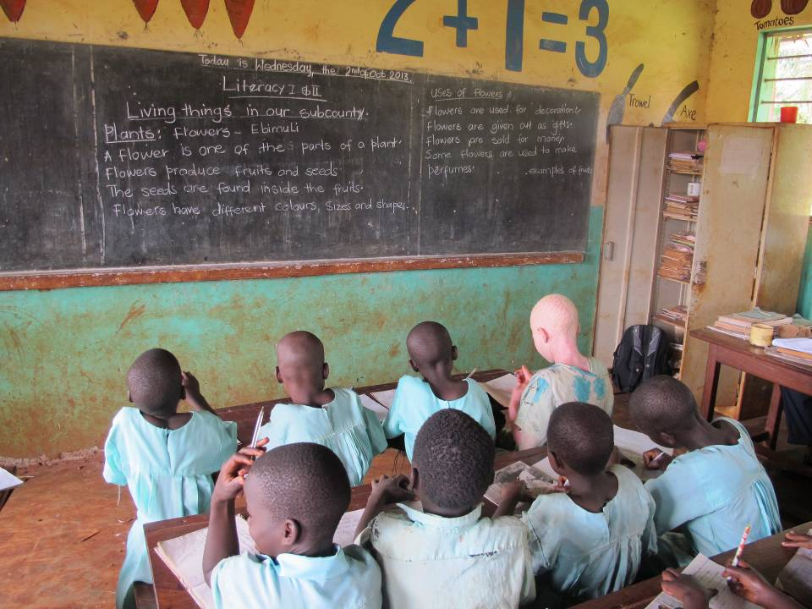
Education

Slide 21
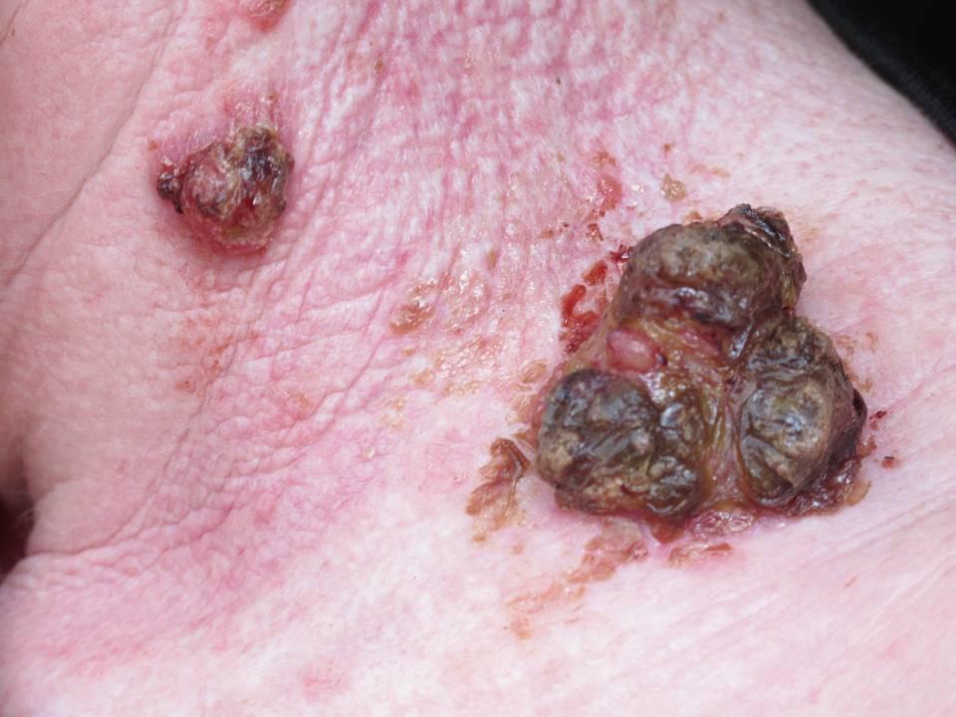
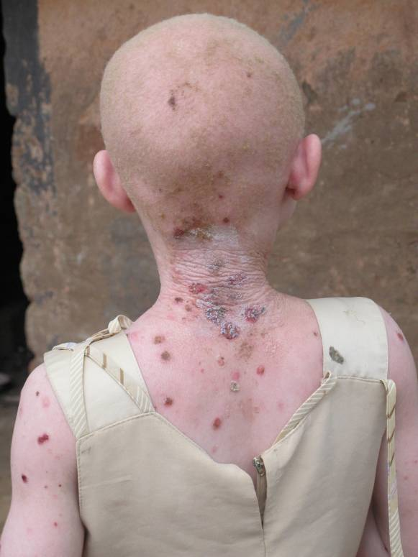
Skin Cancer
Skin cancer

Slide 22
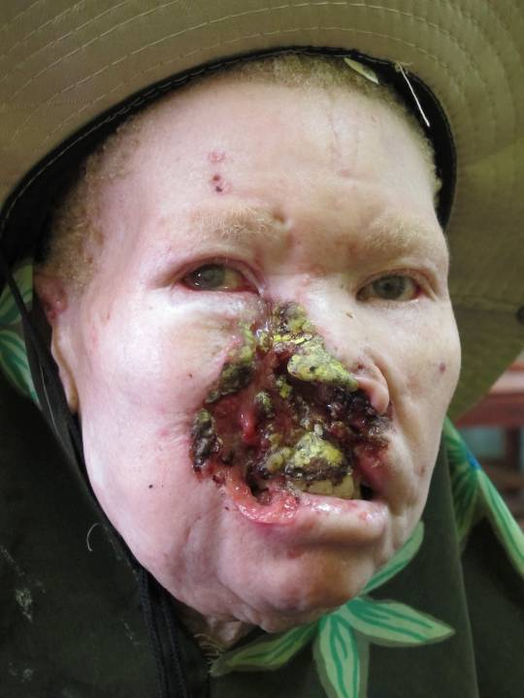
Alaisa

Slide 23
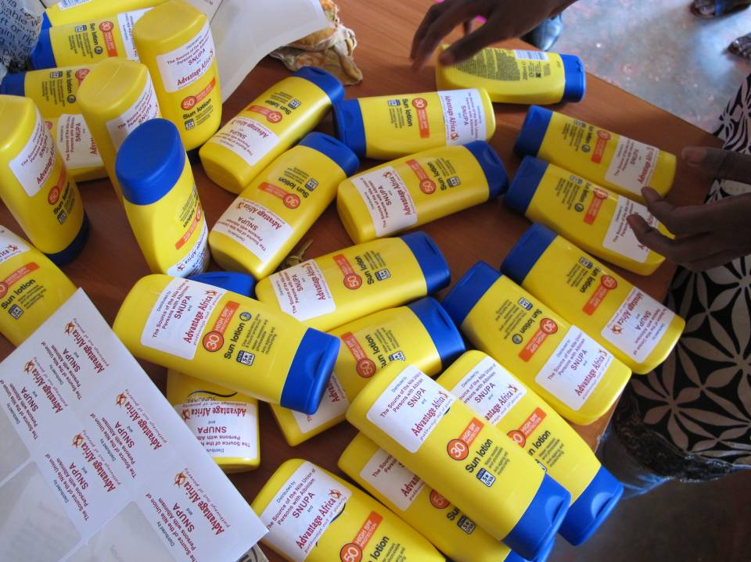
Sunscreen

Slide 24
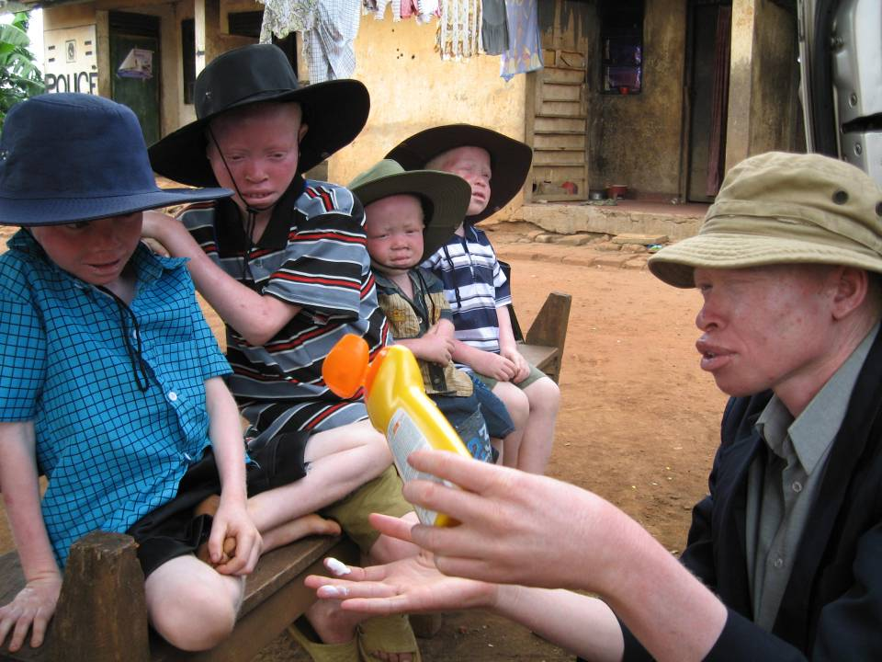
Sunscreen

Slide 25
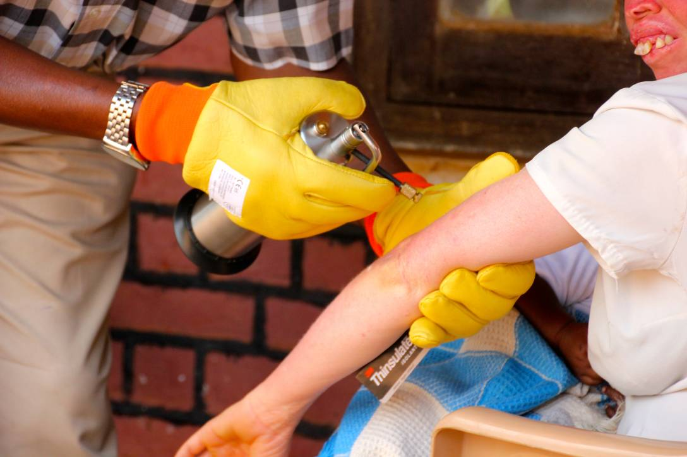
Cryotherapy

Slide 26
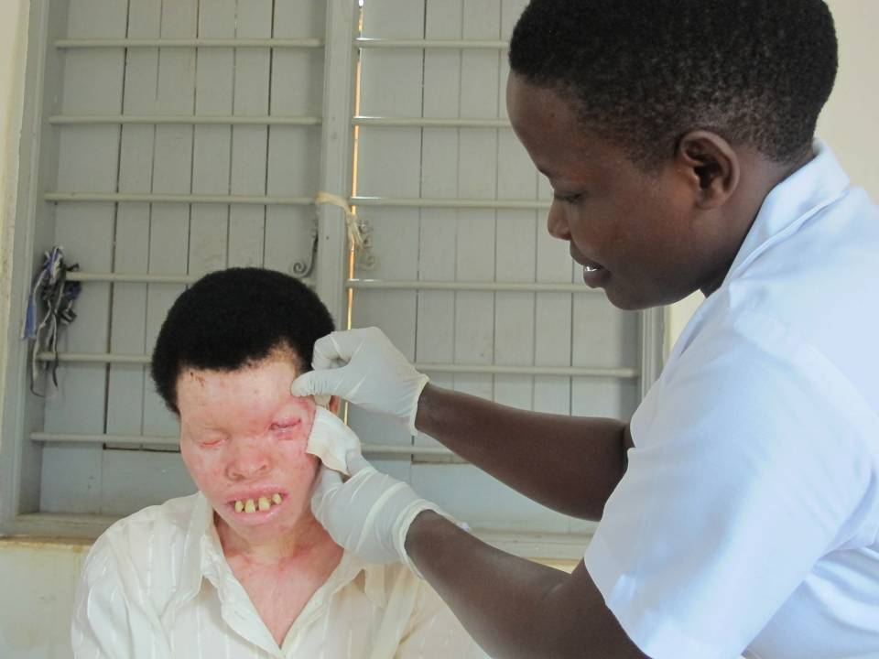
Surgery (Justine)

Slide 27
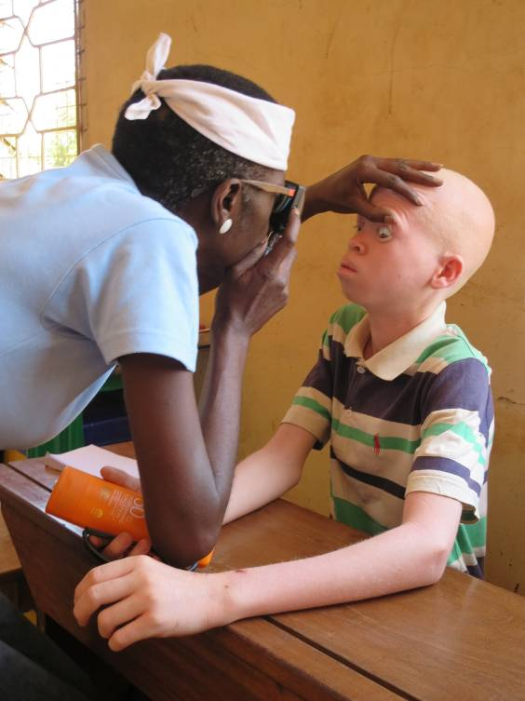
Visual impairment

Slide 28
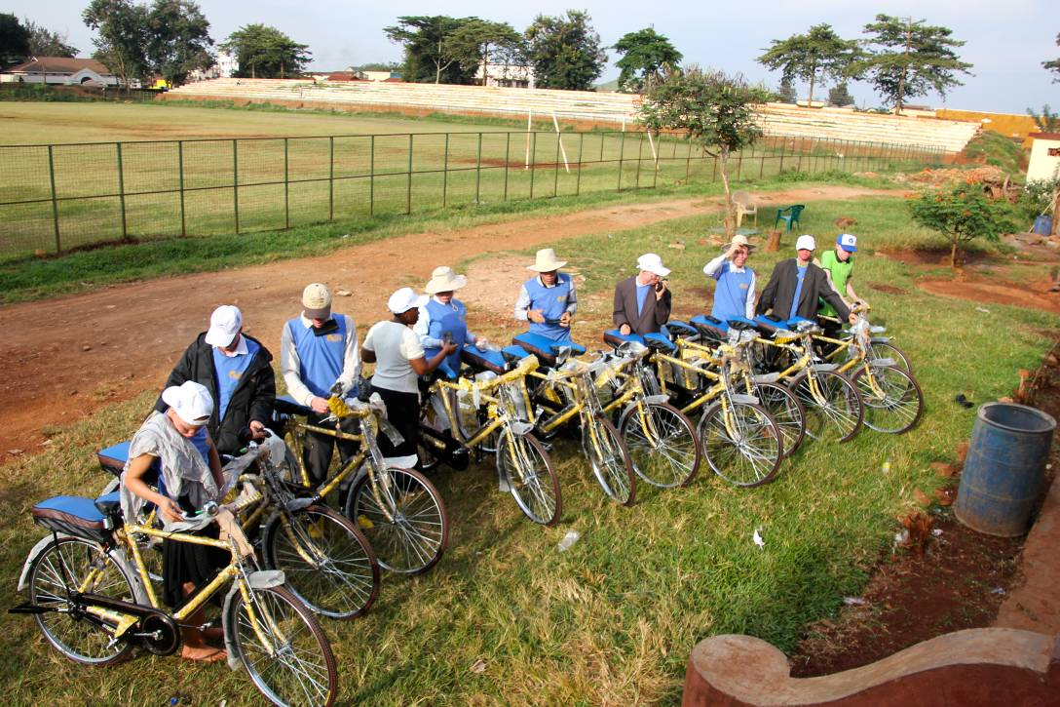
Growing capacity

Slide 29


What have we Learned?
Ignorance, fear and neglect causes exclusion, chronic poverty, and death
Importance of a holistic approach
Practical help needed alongside rights
Complexities of fundraising
Genuine partnership and leadership
It always seems impossible until it’s done
Notes:
29
Light
Stove
Jembe
Water container

Slide 30

Susan

Slide 31
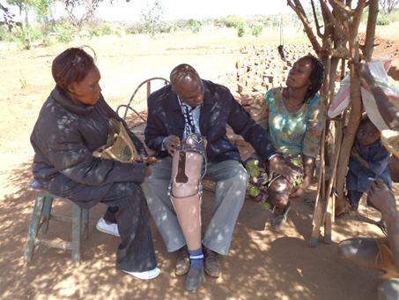

Slide 32
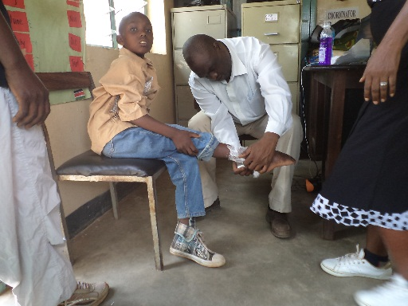

Slide 33
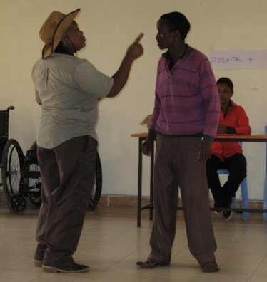

Slide 34
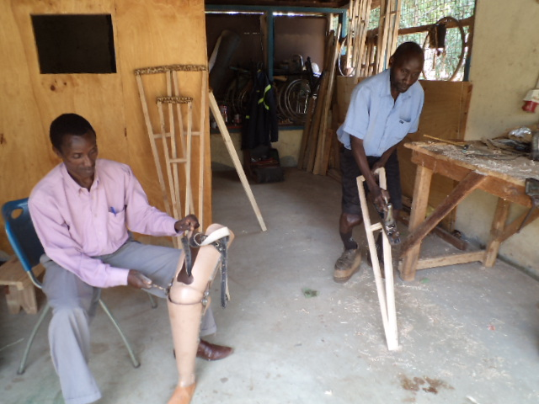

Slide 35
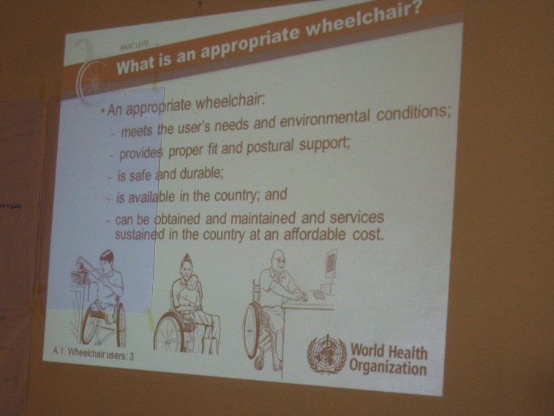

Slide 36
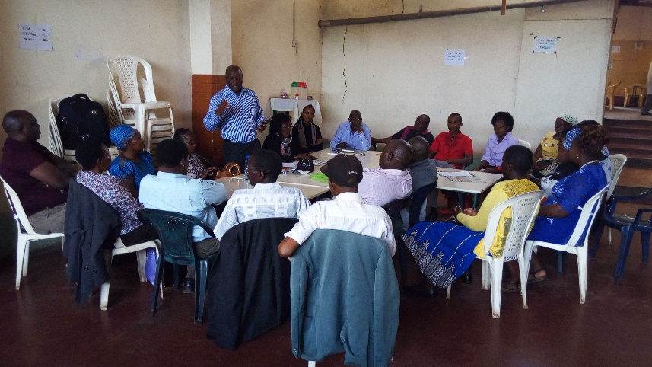

Slide 37
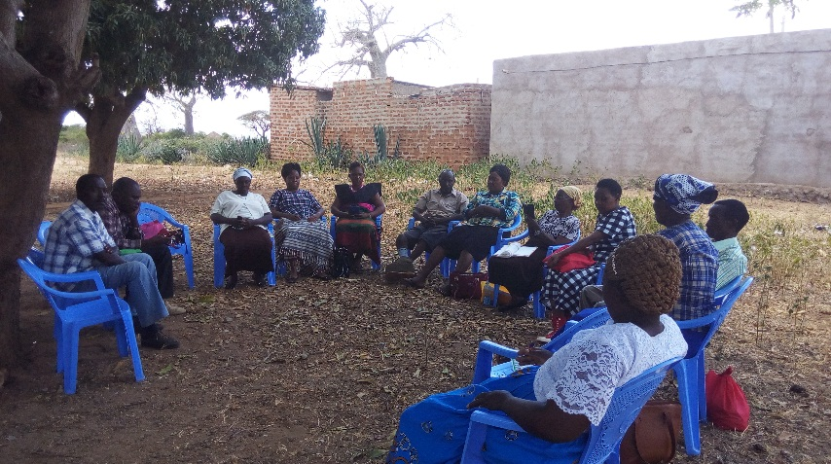

Slide 38
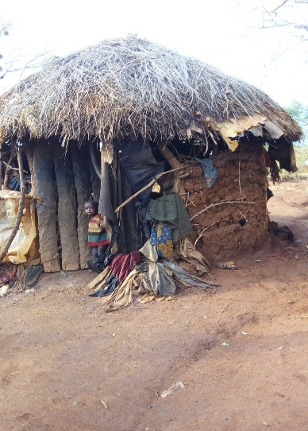
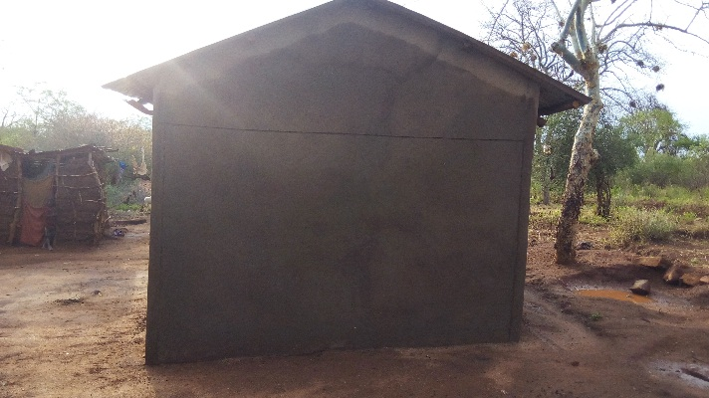

Slide 39
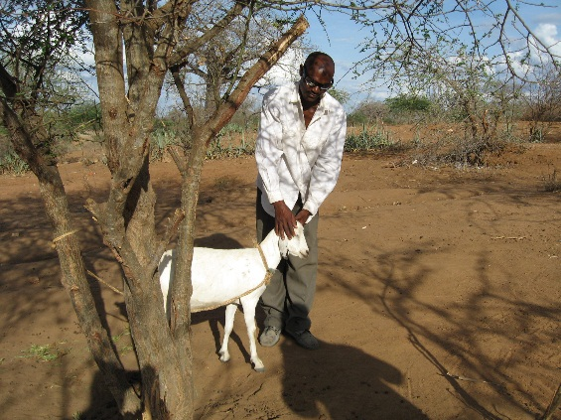

Slide 40
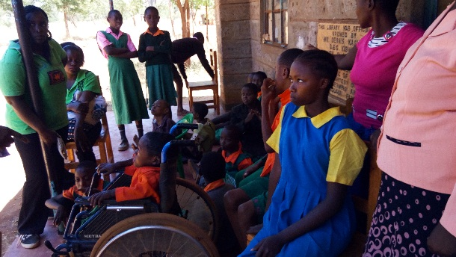

Slide 41
