Slide 1

What is the difference between leadership and management?
Session 17: Managing People
Lillian with
baby Carolyn
Susan

Slide 2
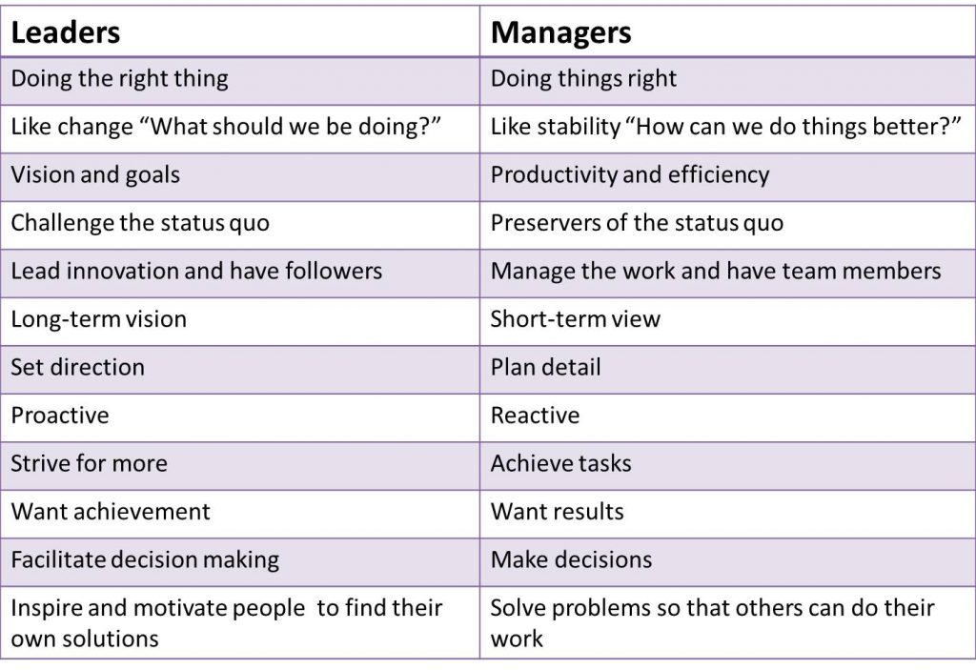

Slide 3
What skills are needed to manage people well?
Lillian with
baby Carolyn
Susan

Slide 4
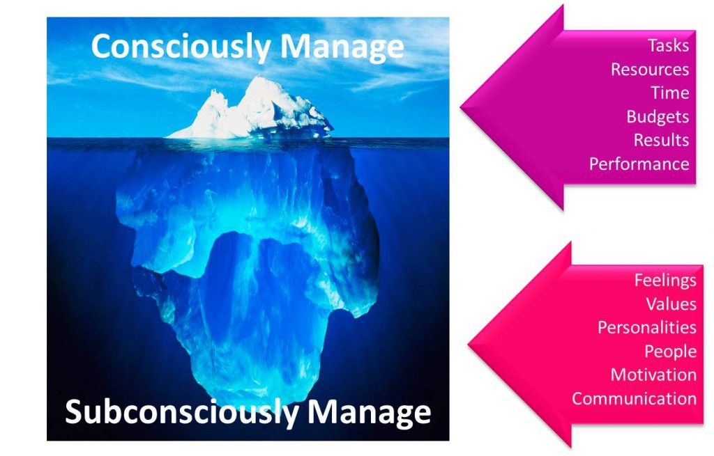
The Management Iceberg

Slide 5
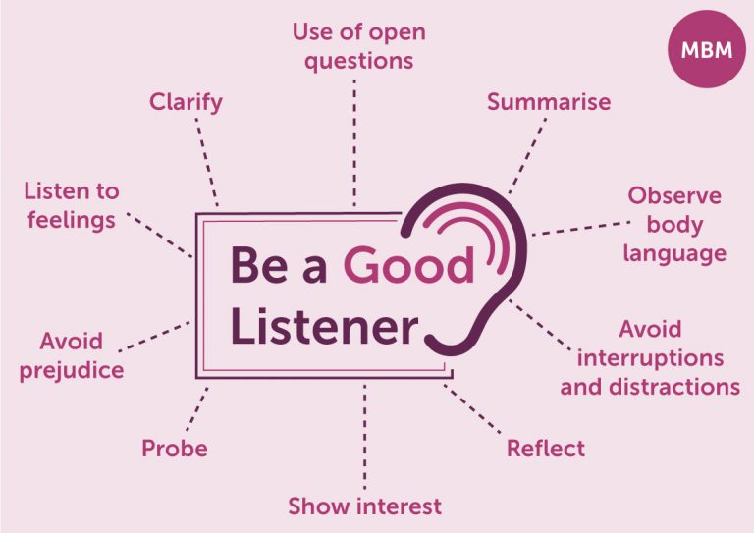
Some tips for managing people well
Lillian with
baby Carolyn
Be someone to lean on
Give your team space
Be a good listener
Share success
Bashir

Slide 6
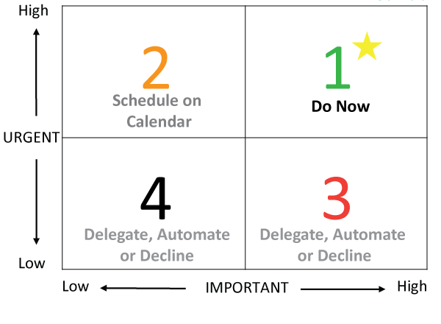
Some tips for managing people well
Lillian with
baby Carolyn
Delegate responsibly
Involve your team
Be confident
Bashir

Slide 7
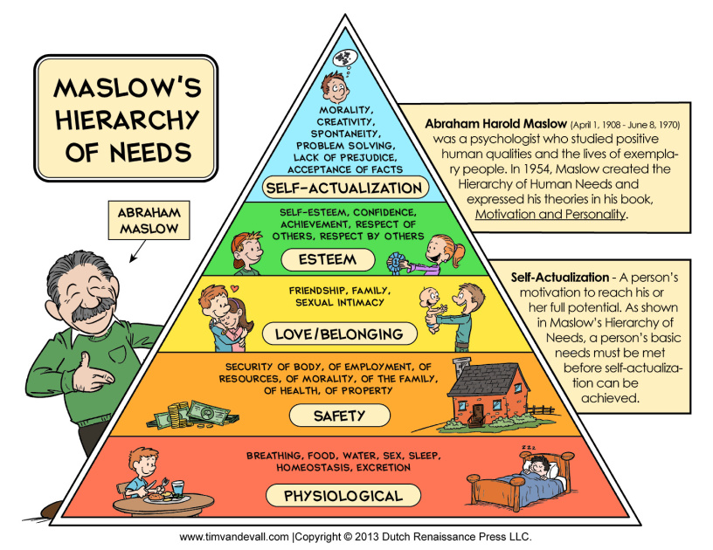
Some tips for managing people well
Lillian with
baby Carolyn
Manage from the front
Trust your instinct
Be compassionate
Set clear objectives
Be ready to change
Bashir

Slide 8
Managing People Questionnaire
Lillian with
baby Carolyn
Susan

Slide 9
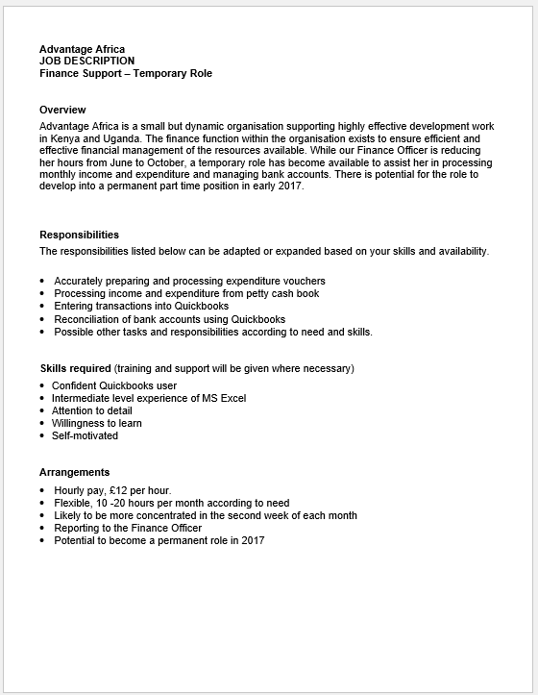
Lillian with
baby Carolyn
Susan

Slide 10
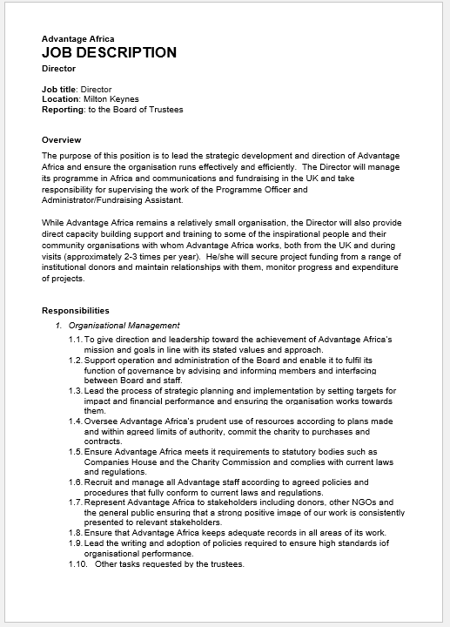
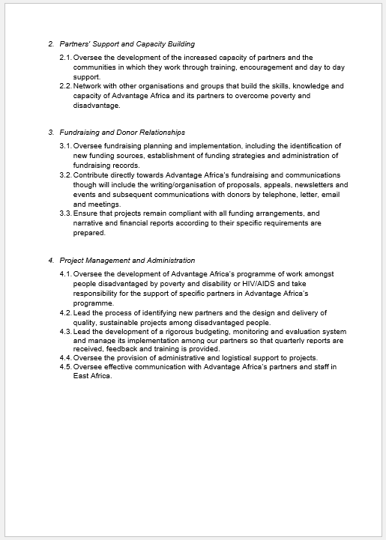
Lillian with
baby Carolyn
Susan

Slide 11
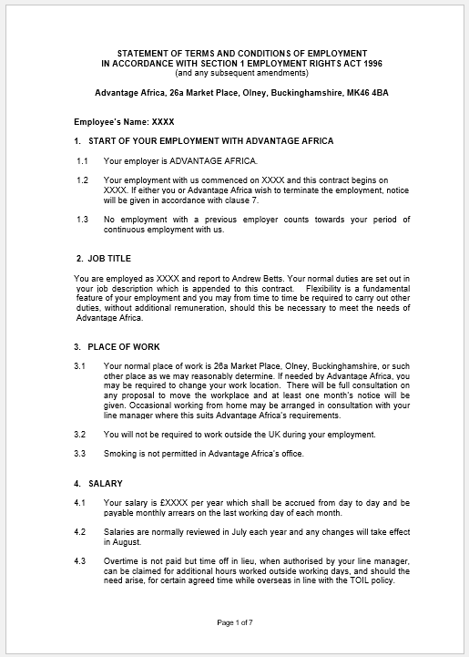
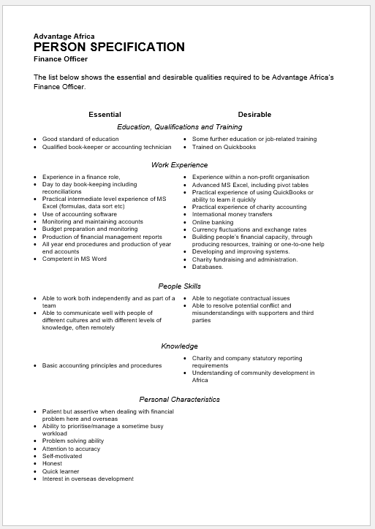

Slide 12
Action Points
Lillian with
baby Carolyn
Susan

